Slide 1
INFS 774 Week 2
Hadoop and HDFS

Slide 2
Overview of Hadoop

Slide 3
What is Apache Hadoop
A software framework for storing, processing, and analyzing Big Data
– Distributed
– Scalable
– Fault tolerant
– Open source
Notes:
Horizonal scaling vertical scaling

Slide 4
Hadoop history
Developed by Mike Cafarella and Doug Cutting
Hadoop is based on work done by Google in the late 1990s/early 2000s
– Specifically, on papers describing the Google File System (GFS) published in 2003, and MapReduce published in 2004
Google is living a few years in the future and sending the rest of us messages.
Notes:
nutch

Slide 5
Why Hadoop?
What problems exist with traditional large scale computing systems?
Data bottleneck
Complex programming
Partial failures
How does Hadoop address those challenges?
What kinds of data processing and analysis does Hadoop do best?

Slide 6
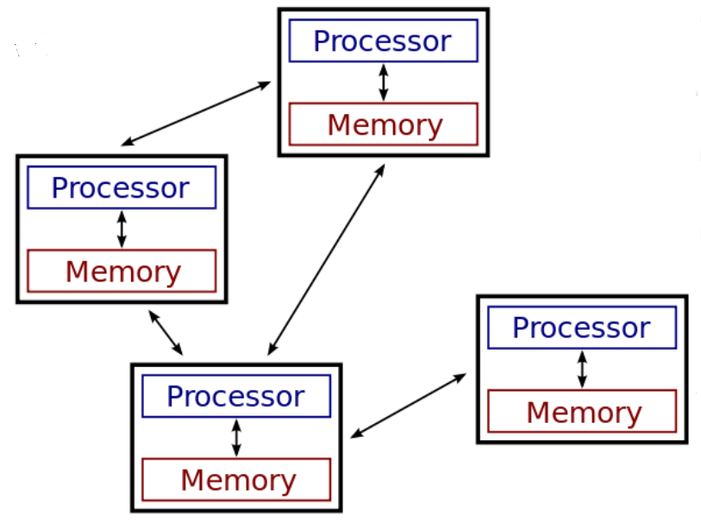
Traditional Large-scale Computation
The early solution: bigger computers
– Faster processor, more memory
– But even this couldn’t keep up
The better solution: more computers
– Distributed systems evolved
– Use multiple machines for a single job
– MPI,(Message Passing Interface),for example
Notes:
Grid computing
Cluster computing

Slide 7
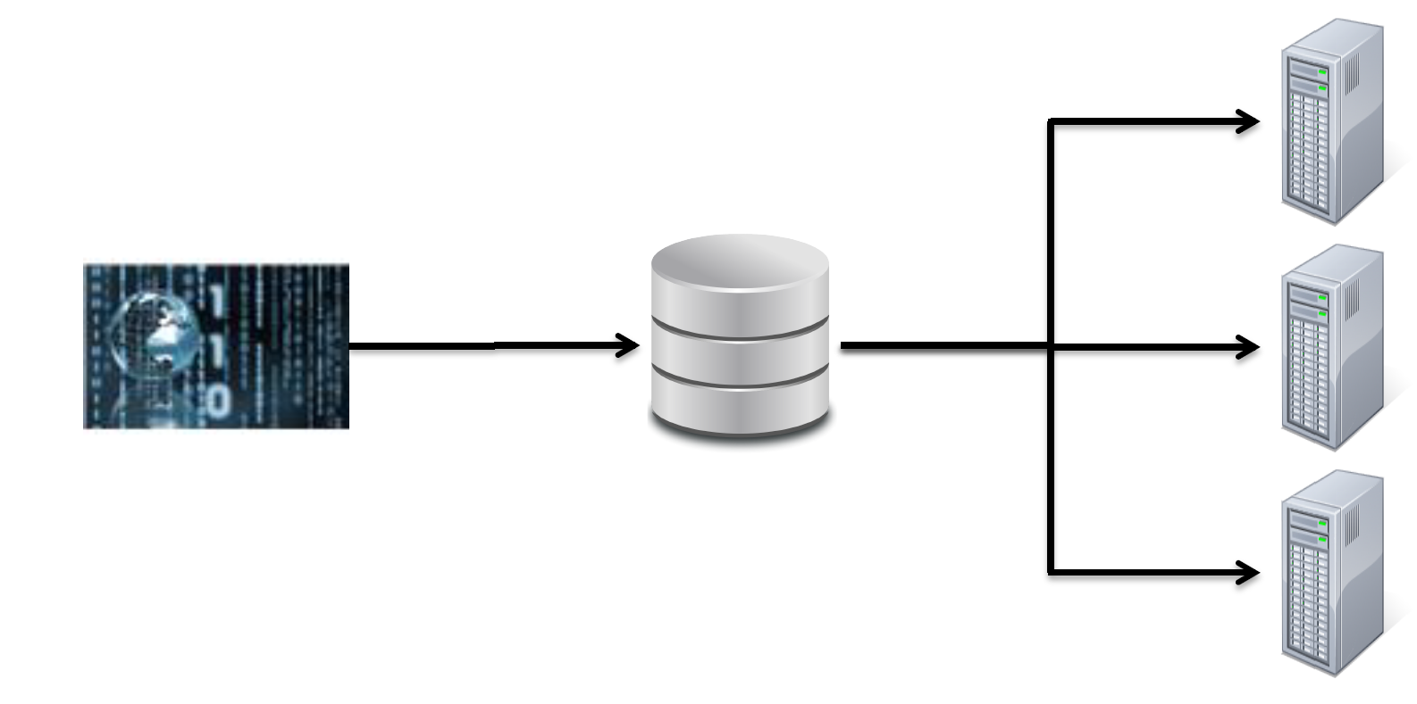
Distributed Systems: The Data Bottleneck
Traditionally, data is stored in a central location
Data is copied to processors at runtime
Fine for limited amounts of data

Slide 8
Distributed Systems: The Data Bottleneck (cont.)
Moore’s Law has held firm for over 40 years
– Processing power doubles every two years
– Processing speed is no longer the problem
Getting the data to the processors becomes the bottleneck
– Typical disk data transfer rate: 75MB/sec
– Time taken to transfer 100GB of data to the processor: approx 22 minutes
– Actual time will be worse, since most servers have less than 100GB of RAM available
Modern systems have much more data
– terabytes+ per day
– petabytes+ total
A new approach is needed

Slide 9
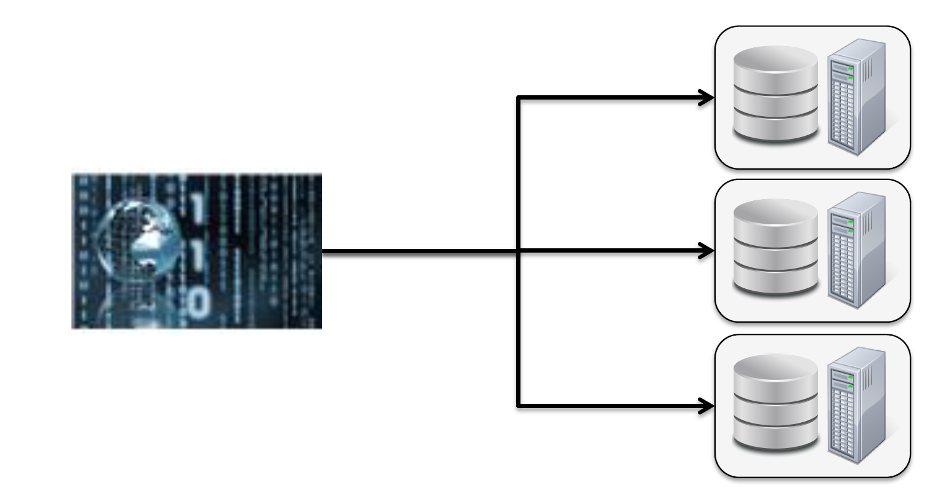
Hadoop Core Concepts
A radical new approach to distributed computing
– Distribute data when the data is being stored
– Run computation where the data is stored
Data Locality

Slide 10
Core Hadoop Concepts (cont.)
Applications are written in high level code
– Developers need not worry about network programming, temporal dependencies or low level infrastructure
Nodes talk to each other as little as possible
– Developers should not write code which communicates between nodes
– ‘Shared nothing’ architecture

Slide 11
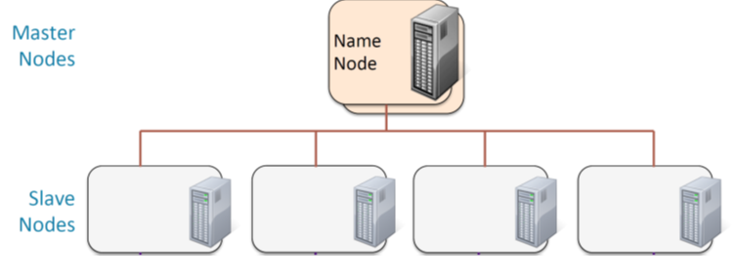
Hadoop Cluster architecture
Four master nodes
– NameNode (active and standby)
– JobTracker (MRv1) or ResourceManager (MRv2) (active and standby)

Slide 12
Hadoop: Very High Level Overview
When data is loaded into the system, it is split into ‘blocks’
– Typically 64MB or 128MB
Map tasks (the first part of the MapReduce system) work on relatively small portions of data
– Typically a single block
A master program allocates work to nodes such that a Map task will work on a block of data stored locally on that node whenever possible
– Many nodes work in parallel, each on their own part of the overall dataset

Slide 13
Fault Tolerance
If a node fails, the master will detect that failure and re-assign the work to a different node on the system
Restarting a task does not require communication with nodes working on other portions of the data
If a failed node restarts, it is automacally added back to the system and assigned new tasks
If a node appears to be running slowly, the master can redundantly execute another instance of the same task. Results from the first to finish will be used
Data is replicated for increased availability and reliability, no loss of data

Slide 14
What are Common Hadoopable Problems?
Nature of the data
– Volume
– Velocity
– Variety
Nature of the analysis
– Batch processing
– Parallel execution
Hadoop is not good for : data modifications, real-time processing, interactive processing, iterative processing, graph-processing, low-latency data retrieval/processing, etc.
Notes:
A->B->c

Slide 15
Hadoop Ecosystem

Slide 16
Hadoop Components
Hadoop consists of two (or three) core components
– The Hadoop Distributed File System (HDFS)
– YARN (Yet another resource negotiator)
– MapReduce
There are many other projects based around core Hadoop
– Often referred to as the ‘Hadoop Ecosystem’
– Pig, Hive, HBase, Flume, Oozie, Sqoop, etc
– Some will be discussed later in the course

Slide 17
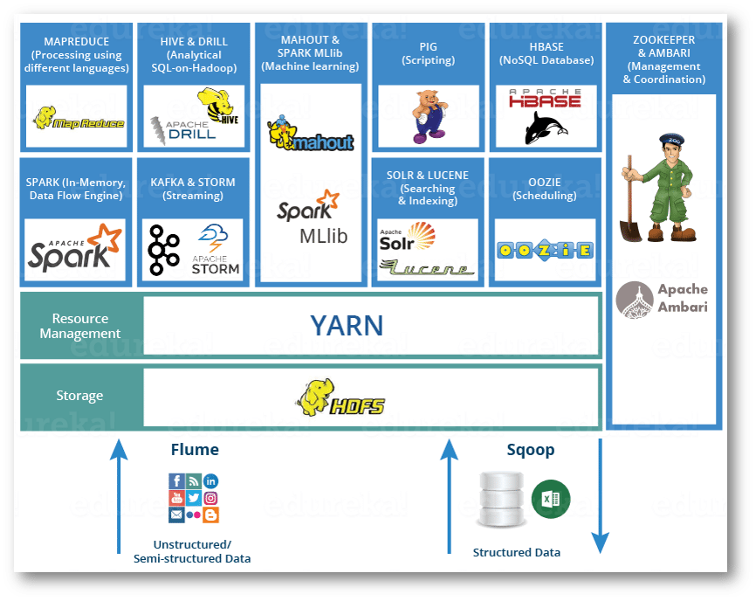
Hadoop Ecosystem

Slide 18
Hadoop Ecosystem
Ecosystem projects may be
– Built on HDFS, Yarn and MapReduce/Spark
– Built on just HDFS and Yarn
– Designed to integrate with or support Hadoop
Most are Apache projects or Apache Incubator projects
Following is an introduction to some of the most significant projects

Slide 19
Hadoop Ecosystem
Data Storage: HBase
Data Integration: Flume and Sqoop
Data Analysis: Hive, Pig,
Workflow Engine: Oozie
Machine Learning: Mahout

Slide 20
HBase
HBase is the Hadoop database
A ‘NoSQL’ datastore
Can store massive amounts of data
– Petabytes+
High write throughput
– Scales to hundreds of thousands of inserts per second
Use plain HDFS if…
– You only append to your dataset (no random write)
– You usually read the whole dataset (no random read)
Use HBase if…
– You need random write and/or read
– You do thousands of operations per second on TB+ of data

Slide 21
Hadoop Ecosystem
Data Storage: HBase
Data Integration: Flume and Sqoop
Data Analysis: Hive, Pig
Workflow Engine: Oozie
Machine Learning: Mahout

Slide 22
Flume: Realtime Data Import
What is Flume?
– A service to move large amounts of data in real time
– Example: storing log files in HDFS
Collect data as it is produced
Process in place ( e.g., encrypt, compress )
Preprocess data before storing (e.g., transform, scrub, enrich)
Store in any format (Text, compressed, binary, or custom sink)

Slide 23
Sqoop: Exchanging Data With RDBMSs
Sqoop transfers data between RDBMSs and HDFS
– Does this very efficiently via a Map/only MapReduce job
– Supports JDBC, ODBC, and several specific databases
– Sqoop = SQL to Hadoop

Slide 24
Hadoop Ecosystem
Data Storage: HBase
Data Integration: Flume and Sqoop
Data Analysis: Hive, Pig
Workflow Engine: Oozie
Machine Learning: Mahout

Slide 25
Hive and Pig: High Level Data Languages
The motivation: MapReduce is powerful but hard to master
The solution: Hive and Pig
– Languages for querying and manipulating data
10 lines of Pig Latin = approx. 200 lines of Map-reduce java code
– Leverage existing skillsets
– Data analysts who use SQL
– Programmers who use scriping languages
– Hive initially developed at Facebook
– Pig initially developed at Yahoo
Interpreter runs on a client machine
– Turns queries into MapReduce jobs
– Submits jobs to the cluster

Slide 26
Hive
What is Hive?
– HiveQL: An SQL like interface to Hadoop
SELECT * FROM purchases WHERE price > 10000 ORDER BY storeid

Slide 27
Pig
What is Pig?
– Pig Latin: A dataflow language for transforming large data sets
purchases = LOAD /user/dave/purchases AS (itemID, price, storeID, purchaserID);
bigticket = FILTER purchases BY price > 10000;
…
Notes:
Purchase -> bigticket -> s

Slide 28
Hadoop Ecosystem
Data Storage: HBase
Data Integration: Flume and Sqoop
Data Analysis: Hive, Pig
Workflow Engine: Oozie
Machine Learning: Mahout

Slide 29
Oozie
Oozie
– Workflow engine for MapReduce jobs
– Defines dependencies between jobs
The Oozie server submits the jobs to the server in the correct sequence

Slide 30
Hadoop Ecosystem
Data Storage: HBase
Data Integration: Flume and Sqoop
Data Analysis: Hive, Pig
Workflow Engine: Oozie
Machine Learning: Mahout

Slide 31
Mahout
Mahout is a Machine Learning library written in Java
Used for
– Collaborative filtering (recommendations)
– Clustering (finding naturally occurring groupings in data)
– Classification (determining whether new data fits a category)
Why use Hadoop for Machine Learning?
– It’s not who has the best algorithms that wins. It’s who has the most data.

Slide 32
Example Data Center with Hadoop

Slide 33
HDFS (Hadoop Distributed File System)

Slide 34
What is a file system
Store data into the named files
Hierarchy of files
Structure and logic rules used to manage files
Notes:
NTFS

Slide 35
HDFS Basic Concepts
HDFS is a filesystem written in Java
– Based on Google’s GFS
Sits on top of a native filesystem
Provides redundant storage for massive amounts of data
– Using readily/available, industry/standard computers

Slide 36
How Files Are Stored in HDFS
Files are split into blocks
– Each block is usually 64MB or 128MB
Data is distributed across many machines at load time
– Different blocks from the same file will be stored on different machines
– This provides for efficient MapReduce processing (see later)
Blocks are replicated across multiple machines, known as DataNodes
– Default replication is three fold
– Meaning that each block exists on three different machines
A master node called the NameNode keeps track of which blocks make up a file, and where those blocks are located
– Known as the metadata

Slide 37
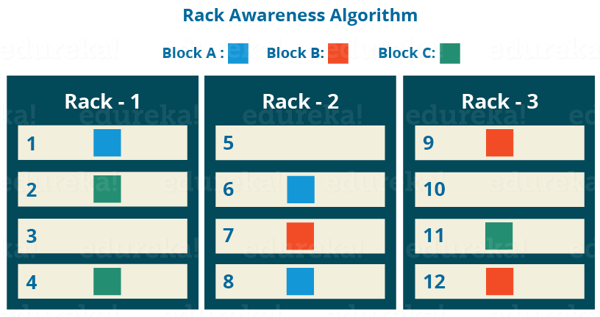
Rack Awareness

Slide 38
NameNode Functions
It is the master daemon that maintains and manages the DataNodes (slave nodes)
It records the metadata of all the files stored in the cluster, e.g. The location of blocks stored, the size of the files, permissions, hierarchy, etc. There are two files associated with the metadata:
FsImage: It contains the complete state of the file system namespace.
EditLogs: It contains all the recent modifications made to the file system with respect to the most recent FsImage.
It records each change that takes place to the file system metadata. For example, if a file is deleted in HDFS, the NameNode will immediately record this in the EditLog.
It keeps a record of all the blocks in HDFS and in which nodes these blocks are located.
It regularly receives a Heartbeat and a block report from all the DataNodes in the cluster to ensure that the DataNodes are live.
In case of the DataNode failure, the NameNode chooses new DataNodes for new replicas,balance disk usage and manages the communication traffic to the DataNodes.

Slide 39
DataNode Functions
These are slave daemons or process which runs on each slave machine.
The actual data is stored on DataNodes.
The DataNodes perform the low-level read and write requests from the file system’s clients.
They send heartbeats to the NameNode periodically to report the overall health of HDFS, by default, this frequency is set to 3 seconds.

Slide 40
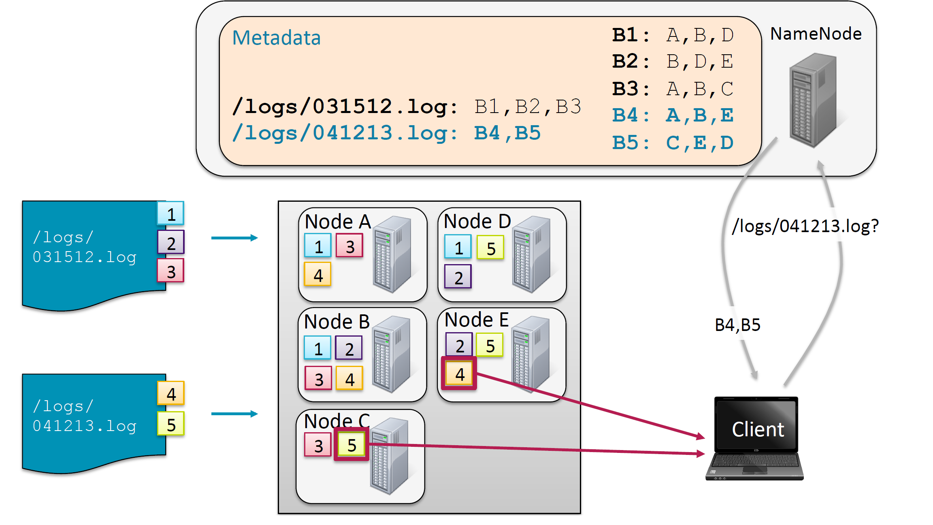
Storing and retrieving files from HDFS

Slide 41
NameNodes Availability
The NameNode daemon must be running at all times
– If the NameNode stops, the cluster becomes inaccessible
High Availability mode
– Two NameNodes: Active and Standby
Classic mode
– One NameNode
– One helper (checkpoint) node called SecondaryNameNode
– Bookkeeping, not backup

Slide 42
Hadoop fs commands
Copy file foo.txt from local disk to the user’s directory in HDFS
$ hadoop fs -put foo.txt foo.txt
– This will copy the file to /user/username/foo.txt
Get a directory listing of the user’s home directory in HDFS
$ hadoop fs -ls
Get a directory listing of the HDFS root directory
$ hadoop fs –ls /

Slide 43
Hadoop fs commands (cont.)
Display the contents of the HDFS file /user/fred/bar.txt
$ hadoop fs -cat /user/fred/bar.txt
Copy that file to the local disk, named as baz.txt
$ hadoop fs -get /user/fred/bar.txt baz.txt

Slide 44
Hadoop fs commands (cont.)
Create a directory called input under the user’s home directory
$ hadoop fs -mkdir input
Delete the directory input_old and all its contents
$ hadoop fs -rm -r input_old

